Slide 1
Widad salih
Inter Penetrating Network Polymers (IPNs)
Lecture six
A Polymer mixtures or blends are widely used materials in modern industry. The chemical and physical combination methods and properties of multipolymers have of great practical and academic interesting.
because they provide a convenient route for the modifications of properties to meet specific needs
An interpenetrating
An interpenetrating polymer network (IPN) is defined as a blend of two or more polymers in a network with at least
one of the systems synthesized in the presence of another (not covalently bonded to each others ). each other
There are several ways to mix two
kinds of polymer molecules

Slide 2
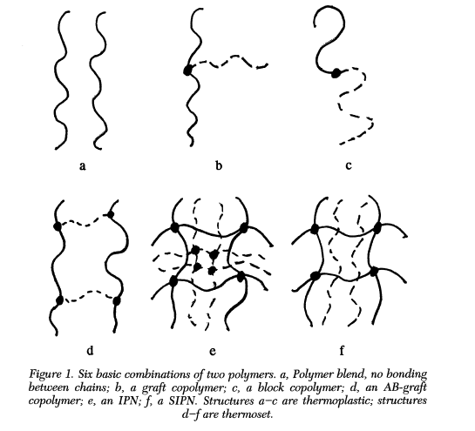

Slide 3
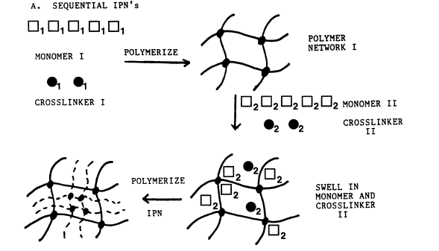
Kinds of IPNs
Sequential IPN. Polymer network I is made. Monomer II plus cross-linker and activator are swollen into network I and polymerized in situ.

Slide 4
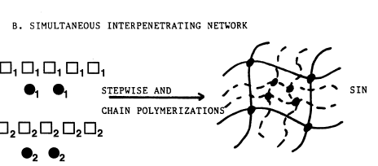
Kinds of IPNs
Simultaneous interpenetrating network (SIN). The monomers or prepolymers plus cross-linkers and activators of both networks are mixed

Slide 5
Kinds of IPNs
Latex IPN. The IPNs are made in the form of latexes, frequently with a core and shell structure
Thermoplastic IPN. Thermoplastic IPN materials are hybrids between polymer blends and IPNs that involve physical crosslinks rather than chemical cross-links. Thus, these materials flow at elevated temperatures, similar to the thermoplastic elastomers, and at use temperature, they are cross-linked
Semi-IPN. Compositions in which one or more polymers arecross-linked and one or more polymers are linear or branchedare semi-IPN (SIPN).

Slide 6
Composite Materials
A composite material is a combination of two materials with different physical and chemical properties. When they are combined they create a material which is specialised to do a certain job, for instance to become stronger, lighter or resistant to electricity. They can also improve strength and stiffness. The reason for their use over traditional materials is because they improve the properties of their base materials and are applicable in many situations.
eramic matrix composite: Ceramic spread out in a ceramic matrix. These are better than normal ceramics as they are thermal shock and fracture resistant
Metal matrix composite: A metal spread throughout a matrix
Reinforced concrete: Concrete strengthened by a material with high tensile strength such as steel reinforcing bars
Glass fibre reinforced concrete: Concrete which is poured into a glass fibre structure with high zirconia content
Fibreglass: Glass fibre combined with a plastic which is relatively inexpensive and flexible
Carbon Fibre reinforced polymer: Carbon fibre set in plastic which has a high strength-to-weight ratio

Slide 8
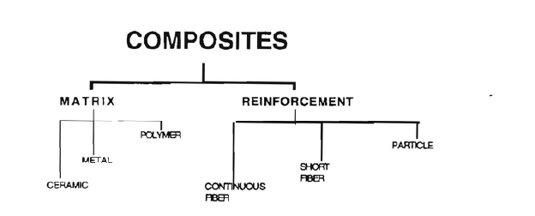

Slide 9
Types of Reinforced Materials

Slide 10
Properties of Composites

Slide 11
-- Lightweight (potentially very high strength-to-weight ratio)
--- High modulus and glass transition temperatures
--- Ability to tailor properties for a wide range of applications
--- Good fatigue resistance
--- Easy to mold and bond to a variety of substrates or other composites
--- Low thermal expansion (along with ability to tailor the CTE in the X, Y, and Z direction)
Tailorable electrical properties
--- Insulating composites with non-conductive fillers such as glass fibers and silica fillers
Conductive composites using silver flake or powders
Advantages of Polymers Composites

Slide 12
--- Advanced composites have a high cost of raw materials
--- Complex manufacturing processes are typically required to ensure low voids and porosity
---- Long development times
--- Low ductility
--- Damage susceptibility and the potential for hidden damage (hard to inspect)
--- Need careful resin selection to minimize moisture and solvent attack
Disadvantages of Polymers Composites

